Slide 1


ITC Infotech Testing Capabilities

Slide 2





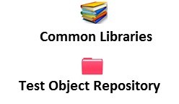









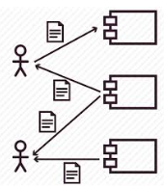





TestNext Automata– An ecosystem for automated Test Life cycle
1. Test Pack Design
2. Test Execution
User Stories
Orthogonal Testing
Assistant
Platform Agnostic Automation Framework
BOTs Assisted Test Execution Platform
BRD / FRD
Manual Test Cases + Automation Scripts
Test Suite
Sanity URL Tester
Testing Tools & Accelerators
Test Execution Assistant
Risk Based Testing
Assistant
Test Accelrators
Governance
Best Practises
Test Management
Domain Expertise
Master Test Data
Shift Left Strategy
Continuous Delivery
4.Test Pack Maintenance
3. Defect Management & Reporting
New Reqs
Test Metrics & Dashboard
Defect Predictive Analytics
100% Updated Test Pack
Defect Reporting
Assistant
Modified Reqs
Automated Impact
Analysis
Defect Retest
Assistant
Test Report Email Assistant

Slide 3
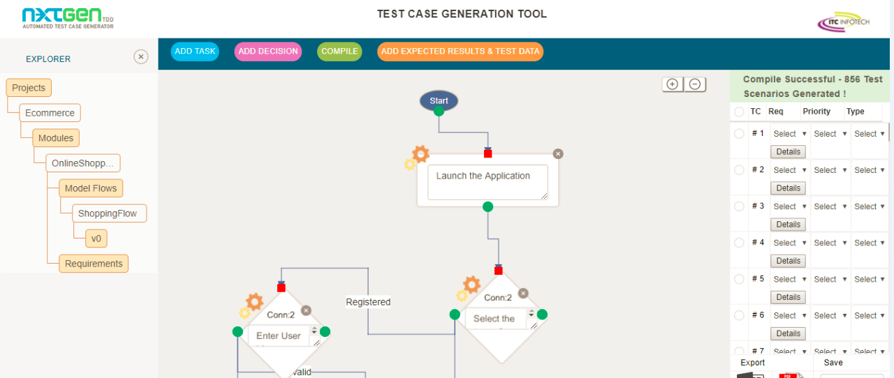
Test Driven Development – Model Based Testing
A web based application for automated Test Case & Skeletal automation script generation from flow diagrams that depict requirements.
Key Benefits
Automated Generation of Test Cases and Test Scripts
Test Cases can be imported to generate Test Scripts
100% Requirement Traceability
45% Effort Saved in Regression Analysis
100% Adoption of Shift Left Strategy
55% Cost & Effort Saved in First Time Test Case/ Script Design
100% accurate Regression Analysis

Slide 4
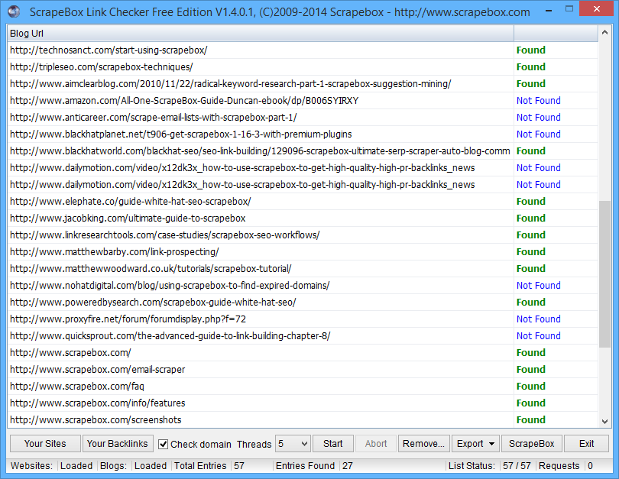
Sanity URL - BOT
A web based application which takes an URL, which can be of a website or a webpage as an input and displays all the URLs contained in all the webpages of that website along with a report of results corresponding to the particular URL. There is also an added feature that can block the opening of URLs which are not relevant to the input URL viz social media sites,third party urls .
Tools required to build the application are:
  Java 1.8.x
  Eclipse Oxygen
  Apache POI
  Appium
  Node/Hub
  Testng

Slide 5
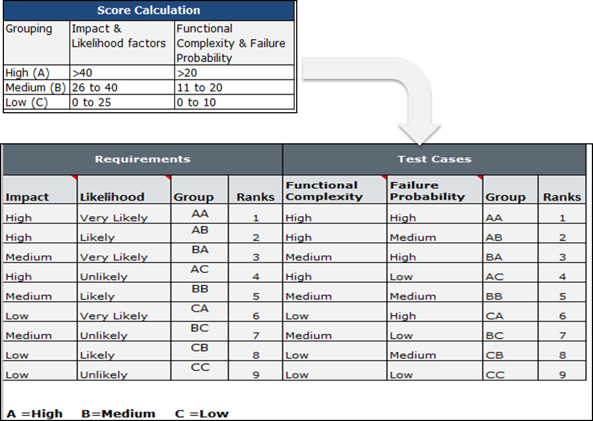
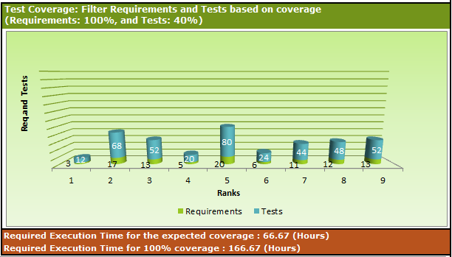
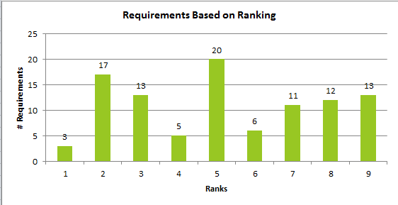
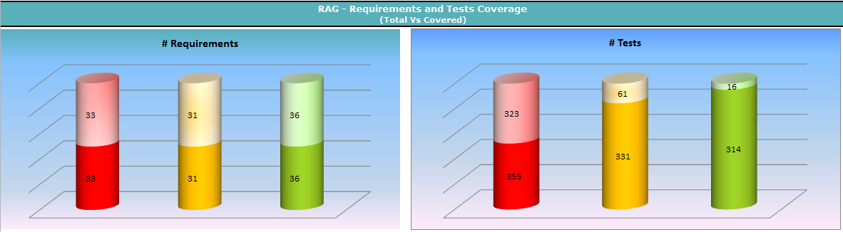
Risk Based Testing Utility
A spreadsheet based accelerator that help testers to prioritize requirements and tests based on Risks, provides recommended test coverage & generate Reports and graphs.
A well-developed methodology ensures that high-risk areas are tested first, then medium-risk areas and, finally, low-risk areas.

Slide 6
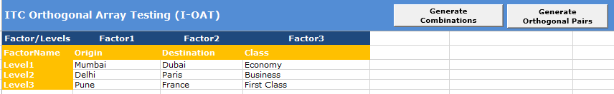
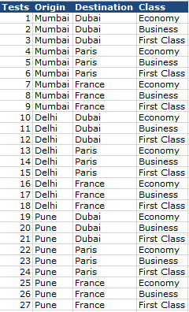
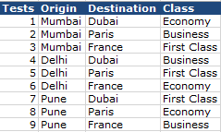
Orthogonal Array Testing - Utility
Orthogonal array testing is an effective test case generation technique that is based on the observation that most faults are caused by interactions of at most two factors. It is a technique that tests the pair-wise combinations of all the selected variables in lesser number of test cases rather than testing all combinations of all variables.
Input Parameters
All Test Combinations
Optimal Test Combinations

Slide 7
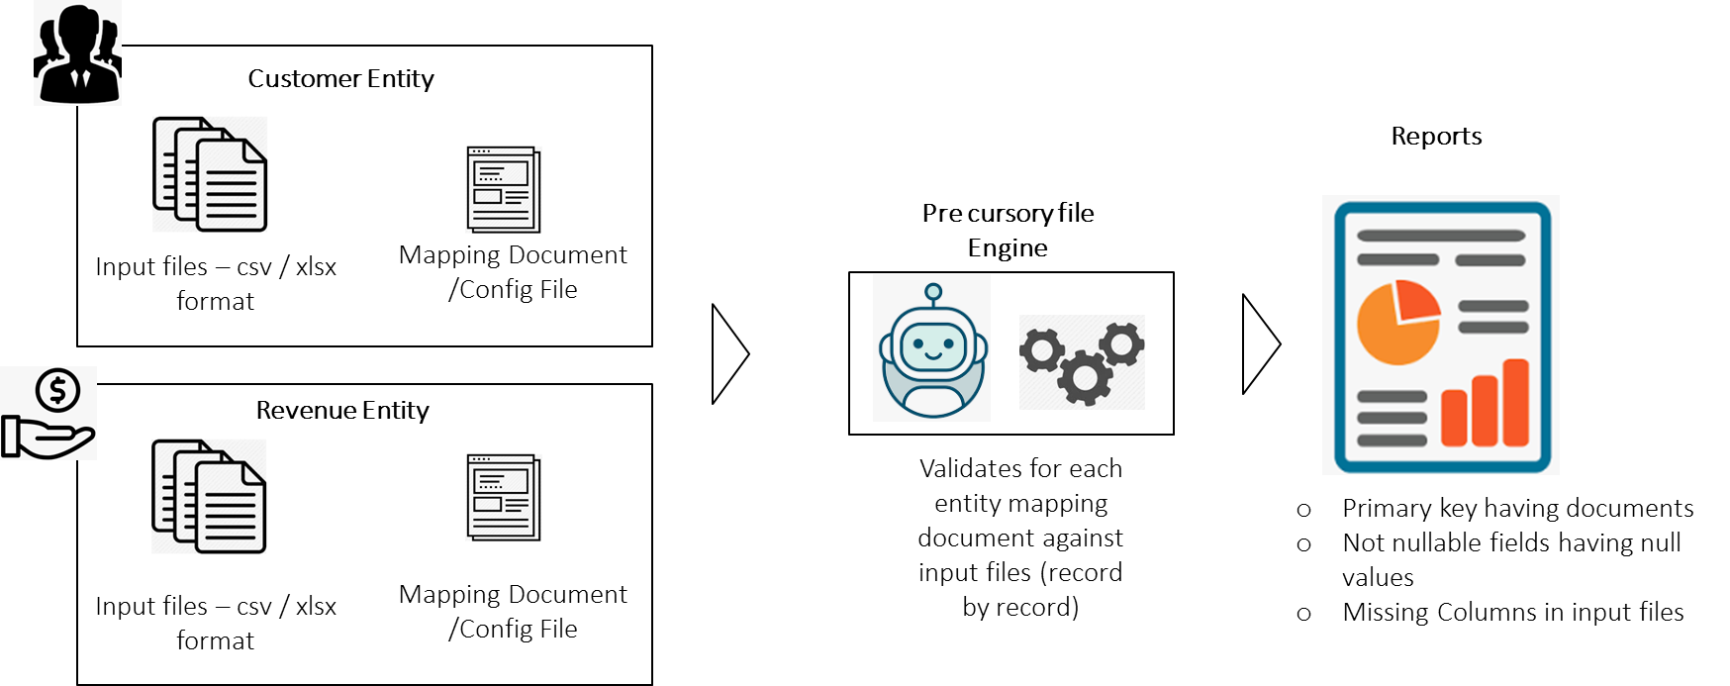
Pre Cursory File Checker – ETL / Big Data Testing Accelerator
Pre Cursory File checker is a Data Testing utility built on Python leveraging Tkinter framework. It enables developers/ testers to evaluate the Sanity of the input files before being processed by ETL job / Big Data jobs.
Key Challenges in ETL Testing w.r.t Flat File validation
Erroneous records in the input files are not unearthed until they are processed by the ETL jobs.
Time taken to update the input files to proceed with testing is time consuming
Getting a first hand feel on the quality of input files is key to expedite end to end testing effort
Key Features of Pre Cursory File Checker
Enables input files to be validated against the config file / mapping document.
Every column and records are verified for compliance against mapping document
Following deviations are highlighted in the report
  Primary key having documents
  Not nullable fields having null values
  Columns present in config file / mapping document and missing in input files
Detailed Reports provided in less than 5 minutes for 30K + records

Slide 8
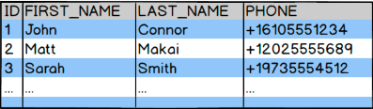


DB Table to Table Comparator
A generic automation utility tool to compare whether multiple databases records are identical before running the ETL job. The tool can help to obtain the following checks.
Primary Key Identification/Validation.
Total Number of records present in both the tables.
Attribute/Entity Validation
Displaying the unmatched records.
Table 1: Table 2:
Python exe
Report

Slide 9
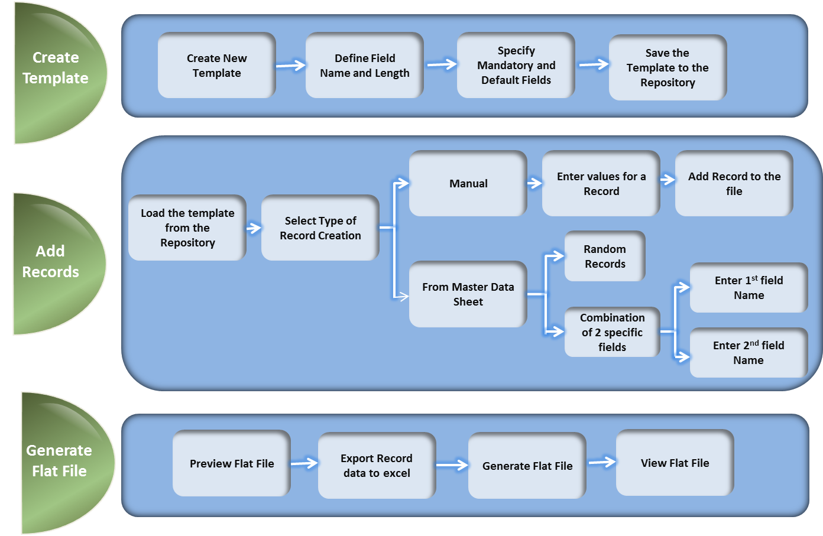
Flat File Generator
A spreadsheet based accelerator that help testers to create flat files for ETL Testing in the event when they do not get production like files for testing.
Key Features
Creates Reusable Templates for Inbound file format.
Stores Repository of Templates.
Provides an option to specify the mandatory fields and default values.
Generate Inbound Flat file from
    Master Data Sheet
        Random records from Master Data Sheet
        Records based on a specific combination of any 2 related fields from the Master Data Sheet
    Manual
  Provides preview of the Flat File
  Validation for manual record creation for the field values based on the field length defined
  Exports the record data in excel format to a specified location for further reference
  Stores Repository of Flat Files Generated

Slide 10
Road Map

